Slide 1
CSS
Bootcamp
Review of CSS
Presented by Steven King

Slide 2
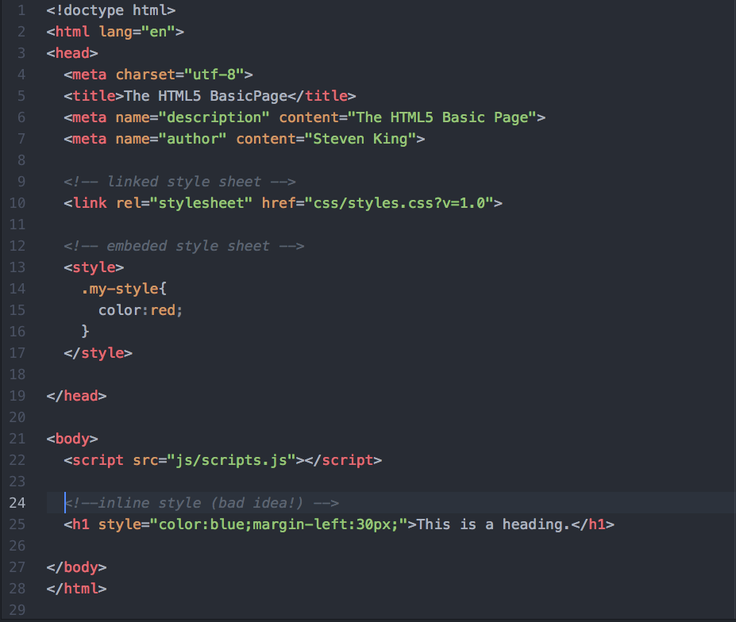
Proximity
Inline
Embedded
External Styles
Overrides from closest to farther from content.

Slide 3
Insert your subtitle text here
CSS Proximity
<tag>
Style=
<style>
<link>
INLINE
EMBEDED
LINKED
Found in HTML
Style tag in head or body
Linked .css stylesheet

Slide 4
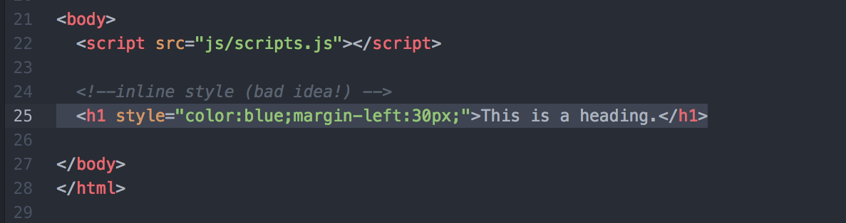
Inline
Found within the html
Not ideal.
User rarely

Slide 5
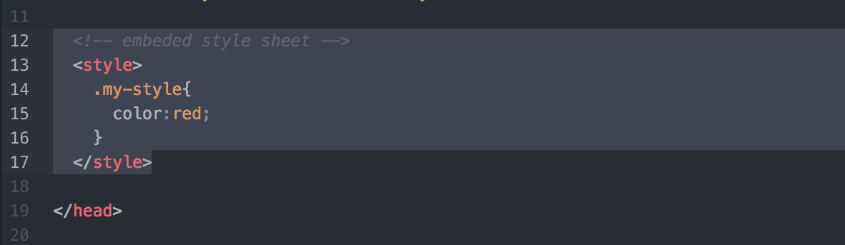
Embedded
<style> tag found in head or body of html

Slide 6
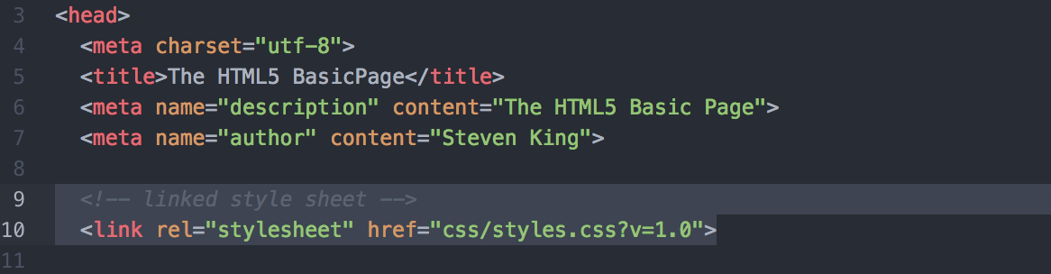
Externally Linked
<link> tag in head
Ideal for expendability
Best way!

Slide 7
The
Cascade
Understanding the C

Slide 8
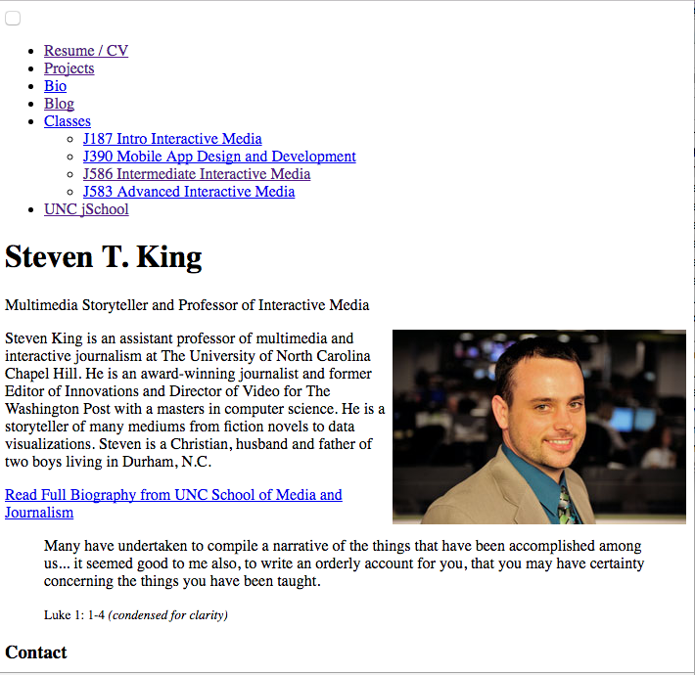


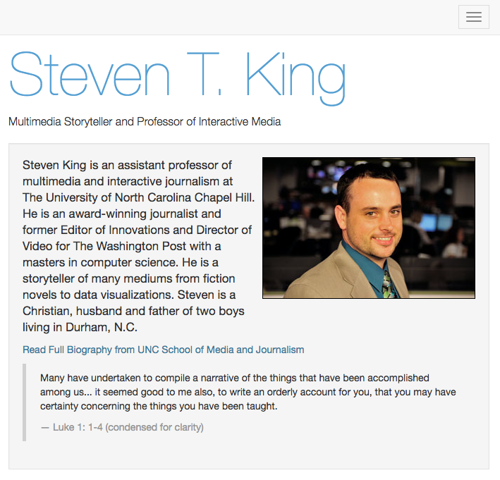

Insert your subtitle text here
Understanding the Cascade
Browser Default
Link Default Blue
User Defaults
All links are made purple (not often)
Document Styles
Links are #56A0D3 (css sheet)
Think of dropping the element in at the top and as it moves down, each rule gets its chance to make changes.

Slide 9
Inheritance
Making CSS work for you

Slide 10
<BODY>
Inheritance
Think Big and get specific
Everything in inherited by default.
Simplifies the amount of code but can be hard to figure out.
<Tags>
ID, Class
<p>
<h tags>
#content . blue

Slide 11
Inheritance is a way of propagating property values from parent elements to their children.
Inheritance
<BODY>
<Tags>
ID, Class
<p>
<h tags>
#content . blue

Slide 12
Selectors
How to choose and element

Slide 13
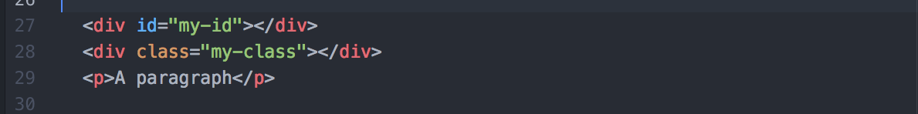
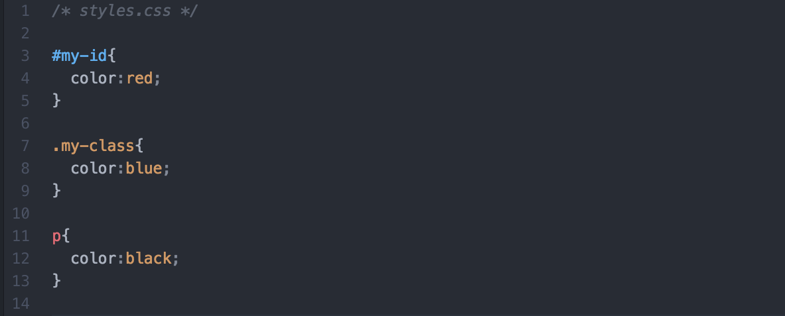
CSS
Selectors
Specifically selectors specify the part of our page we want to apply properties to. Like a stencil, as the movie mentioned.
The part in HTML, typically the <div>s and tags.
Type, ID and Classes

Slide 14
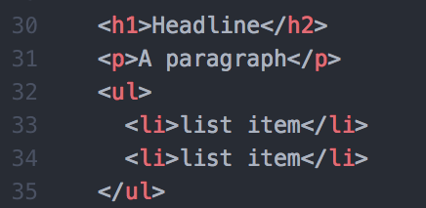
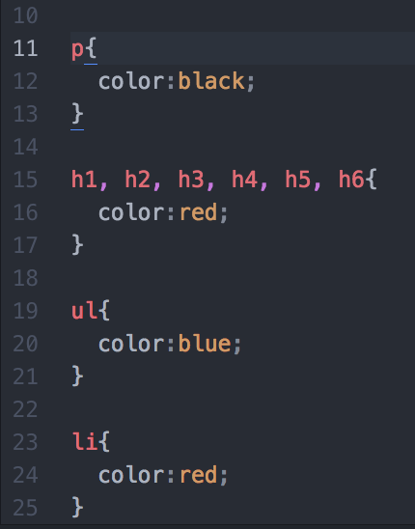
Type
Selectors
Type selectors are the simplest selector. They refer directly to an HTML tag
No # or .

Slide 15
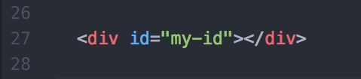
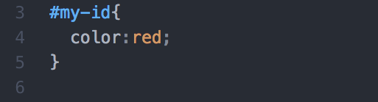
#ID
Selectors
For a Single Element.
USE ONLY ONE TIME
Used for structure like footer

Slide 16


.class
Selectors
For multiple elements
Style anything, most common

Slide 17
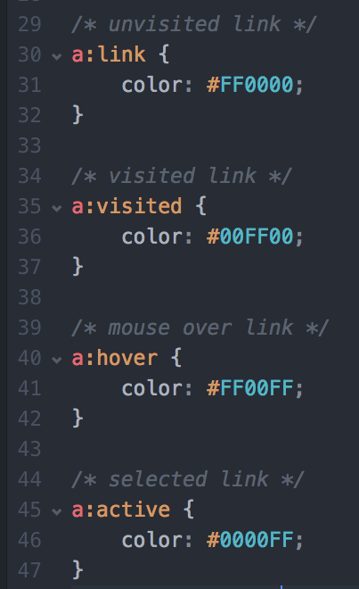
Pseudo
Classes
For various states of an element
Most common are links and buttons
:

Slide 18
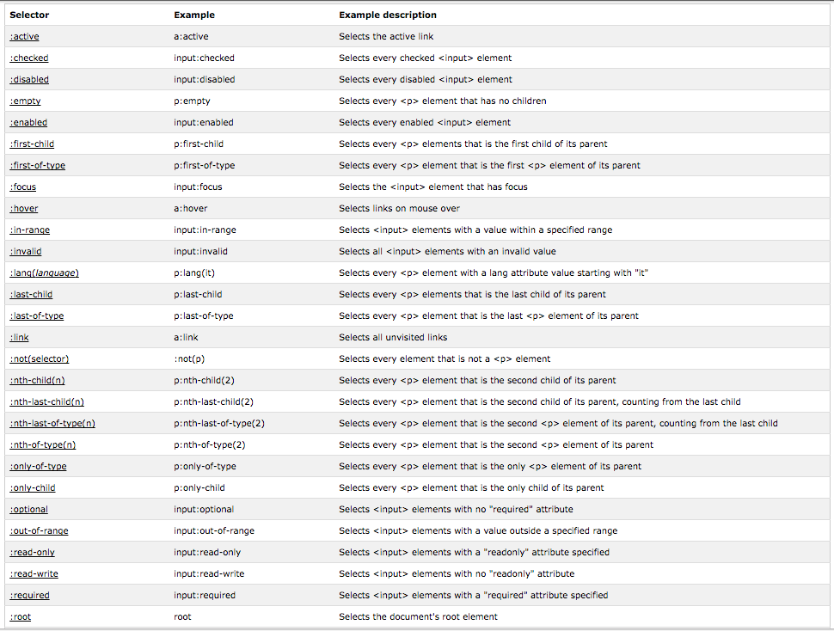
Pseudo
Selectors
There are a few…

Slide 19

Using HTML
Attributes
HTML Element Attribute for #ids and .classes

Slide 20

Compound
Selectors
Very specific target

Slide 21
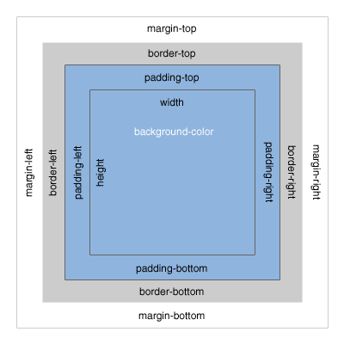
The Box
Model
Understanding how things relate

Slide 22
Box
Model
Margin = Outside
Padding = Inside
Top, Right , Bottom, Left

Slide 23
Understanding Padding and Margin
Box Model
SERVICE 1
SERVICE 2
SERVICE 3
SERVICE 4
SERVICE 5
Mobile social media refers to the combination of mobile devices
Mobile social media refers to the combination of mobile devices
Mobile social media refers to the combination of mobile devices
Mobile social media refers to the combination of mobile devices
Mobile social media refers to the combination of mobile devices
Analysis
Mobile social media refers to the combination of mobile devices and social media. This is a group of mobile marketing applications that allow the creation and exchange of user-generated content. Due to the fact that mobile social media run on mobile devices, they differ from traditional social media by incorporating new factors such as the current location of the user or the time delay between sending and receiving messages

Slide 24
Assignment
Putting into practice

Slide 25
